Slide 1
Chapter 4 & 5
Newtonian Mechanics
Newton’s Law
Some Particular Forces
The Dynamics in Noninertial Frame
Applying Newton’s Laws

Slide 2
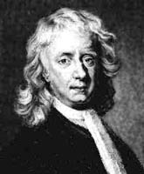
Dynamics studies the rule on the interaction force between bodies and examines the causes of motion.

Slide 3
4-1. Newton’s Law on Motion (P78)
1. Newton’s first law — inertial law
If no net force acts on a body, then the body’s velocity cannot change; the body cannot accelerate (任何物体都保持静止或匀速直线运动状态，直到作用在它上面的力迫使它改变这种状态为止).
Supplementary explanation:
1) The concept of Inertia(惯性): The mass is an intrinsic characteristic of a body, it characterizes the inertia of the body.

Slide 4
2) The force is the only reason which makes the states of body change. It indicates the concept of force: An interaction —–can cause an acceleration of a body.
3) Inertial Reference Frames (IRF) (惯性参考系): An inertial frame is one in which Newton’s laws hold.

Slide 5
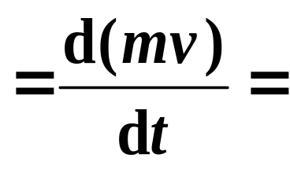
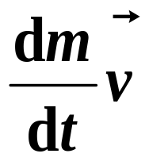
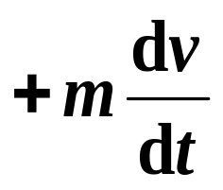
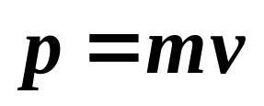
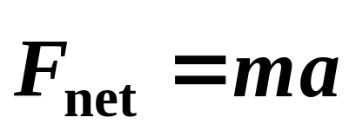
2. Newton’s second law
❒
❒
d
p
F
=
d
t
where is momentum (动量) of body.
So in classical mechanics, it can be expressed as:
Unit and dimension:
newton (N) 1N = 1kg · m/s² [MLT⁻²]

Slide 6
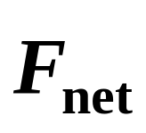
Supplementary explanation:
1. It is a law of force’s instantaneous interaction (瞬时作用规律). Force is the causes of motion.
2. It is only suitable for the inertial frame, and particles or particle-like bodies. To solve problems with it, a free-body diagram need to be drawn.
3. is the vector sum of all net external forces.

Slide 7
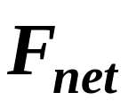
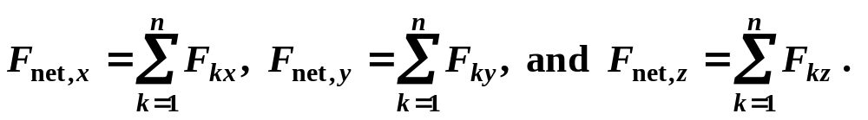
4. If several forces act on a body at the same time, the resultant force should be:
5. The component forms of N-II Law:
—– The acceleration component along a given axis is caused only by the sum of the force components along that same axis, and not by force components along any other axes (力的独力性原理或力的叠加原理）.

Slide 8
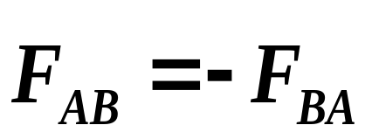
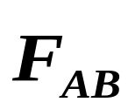
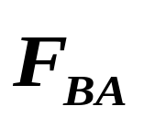
3. Newton’s third law
A
B
Supplementary explanation:
1) Simultaneous;
2) Same type of force;
3) Acting on different bodies, do not cancel each other.
Hey!
The third-law force pair act on different bodies.

Slide 9


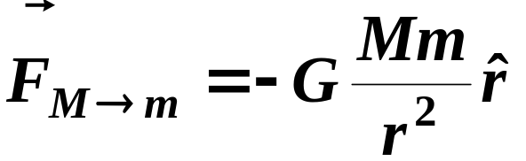

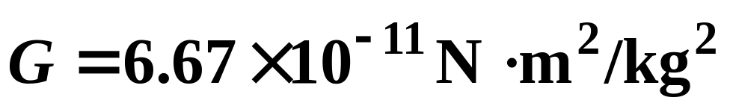
4-2. Some Particular Forces
1. The gravitational force (P134 & 85)
Newton’s form of the law of gravitation(万有引力) :
According to the Newton’s assumption: F₁∝Mm and F₂ ∝ mM and include the inverse square law condition, one get
m
r
M
o
where directs away from its origin. The gravitational constant (universal) (万有引力常量)

Slide 10
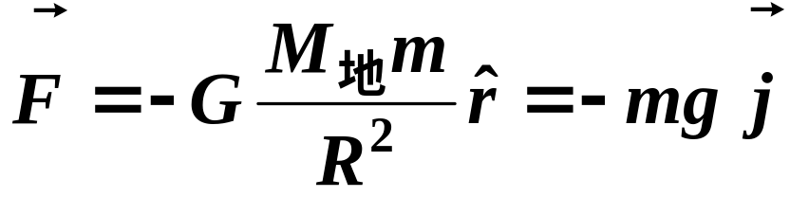
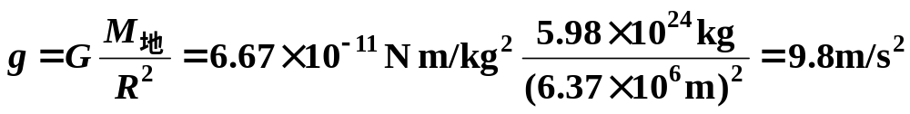
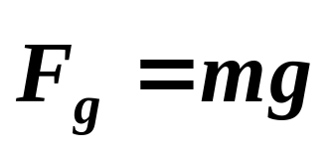
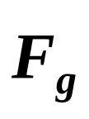
For a body on the ground, of mass m ,
y
where is also called gravitational force (重力) —— a special case of gravitation (万有引力).
m
M
R
The magnitude of (the gravitational force on the body) is called the weight W of a body.

Slide 11
Weight and mass:
W =mg —— Weight-mass relation
Explanations:
(i) If the distances covered in particle motion << R_{earth}, weight may be assumed to be constant.
(ii) The weight of a body must be measured when the body is not accelerating vertically relative to the ground.
(iii) The body’s mass is an intrinsic property (固有性质) of the body, but weight changes in the places where the value of g is different.

Slide 12
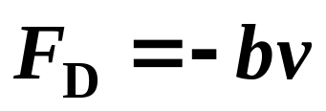
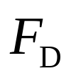
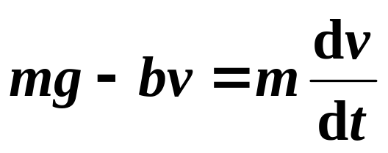
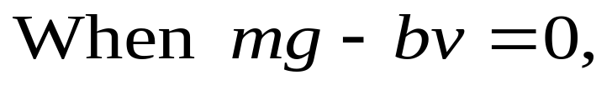

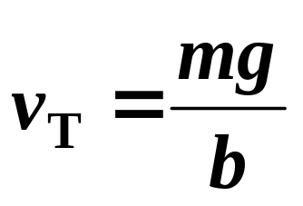
2. Velocity-dependent forces; terminal velocity (P120)
When a body moving through a liquid or gas, the body experiences a drag (粘滞) force F_{D} that opposes the relative motion and points in the direction in which the fluid flows relative to the body. It depends on the velocity of the body:
—— drag force
two forces are equal,
and the body reaches its terminal velocity v_{T}:

Slide 13
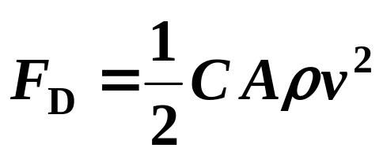
For objects moving at high speeds, such as an airplane, a skydiver, or automobiles, … , the force of air resistance can be better proportional to v².
In these cases:
Where, C —— drag coefficient, ρ ——the density of the fluid, A ——the effective cross-sectional area of the body and v —— relative speed.
According to the formula, the drag force decreases as the air density decreases . this is one reason why jets fly at high altitudes.

Slide 14
4-3. Dynamics in Noninertial Frame
1. Inertial and noninertial reference frame
An inertial RF is one in which Newton’s laws hold;
A noninertial RF is one in which Newton’s laws do not hold;
2. Fictitious (inertial ) forces:
To use Newton’s laws to calculate the motion of a body in noninitial RF, we may assume that a fictitious (inertial) force acts on the body.
Such pseudoforces arise only because the RF is not an inertial one, and no body exerts this force.

Slide 15
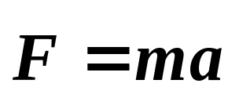
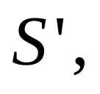
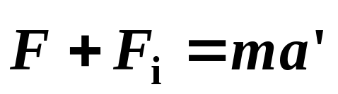
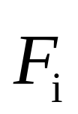
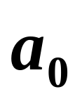

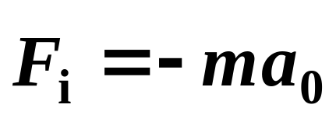
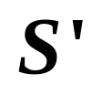
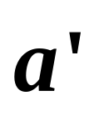
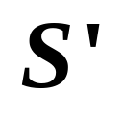
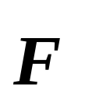
Take an example as below Fig. shown:
For inertial RF S, , and
for noninertial RF
Where is an inertial force,
S’
Notes！
S
is the acceleration of frame relative to S.
is the acceleration of the body relative to .
is the vector sum of all net external forces except the inertial force acting on the body.

Slide 16
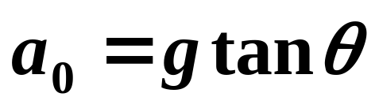
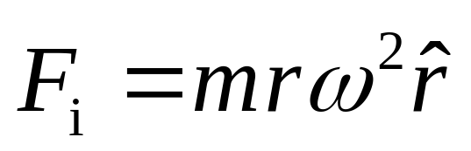

Example:
F_{T}
θ
S
ma₀
S '
mg
a₀
❒
❒
❒
m
g
+
F_{T}
+
F
=
0
i
The above conclusion can also be extended to rotational noninertial RF (P287).
r

Slide 17
4-4. Applying Newton’s Laws
Problem solving guide (P94):
Pick a body based on the feature of problem (研究对象);
Draw a free-body diagram (画出隔离体的示力图);
Choose coordinate axes (建立较方便的坐标系);
Resolve vectors along chosen axes (沿轴分解矢量);
Apply Newton’s laws of motion (列方程,统一单位,求解);
Decide whether or not the solution makes sense.
Note: Try to choose one axis in the direction of the acceleration. It may simplify the algebra.
Note:

Slide 18


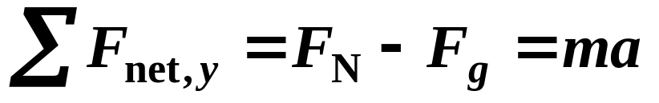
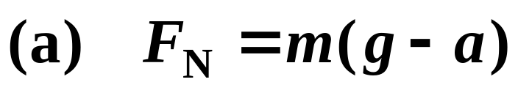
y
Example:
A woman of mass m =65kg, stands on a platform scale in an elevator. What does the scale read if (a) the elevator accelerates downward at 0.20g. (b) the elevator descends at a constant speed of 2.0m/s.
Solution:
Pick the woman as a particle;
(2) Choose the ground to be the inertial frame and make any measure relative to it.

Slide 19
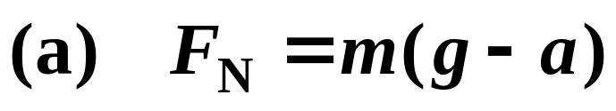

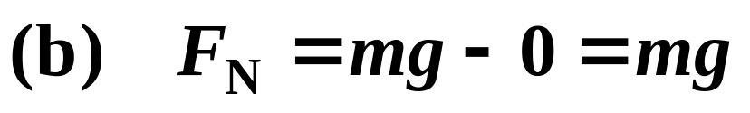
Answer:
y
❒
F_{N}
F_{N}
=
mg
−
0
.
20
mg
=
0
.
80
mg
Her weight is mg, but the scale shows her mass as 0.80mg.
Discussion:
In the noninertial reference frame of the accelerating cab, they are not equal to and N-II law does not hold.
∴
F_{N}
=
mg
The scale reads her correct mass in this case.

Slide 20


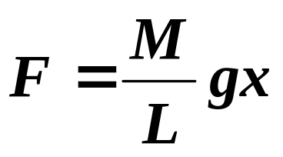
Example:
A chain has length L and mass M, and was put on a frictionless table. At t = 0, the chain is stationary and length l is hanged over the edge. (a) What is the velocity at the moment that the whole chain leave the table (整个链条刚离开桌面时的速度) ? (b) The time covered the whole process (由开始运动到完全离开桌面所经历的时间)?
L-l
Solution:
O
(a)
Consider the moment of l=x,
x
（Variable）
x

Slide 21
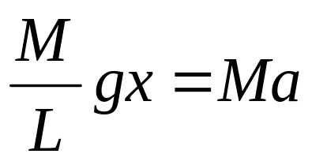
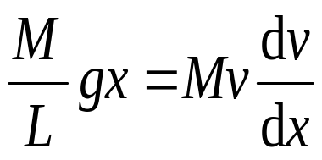
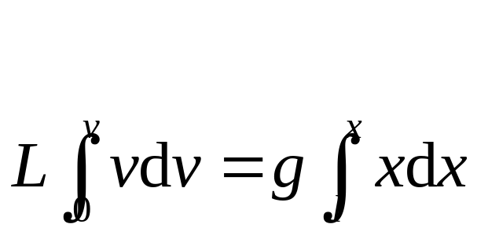
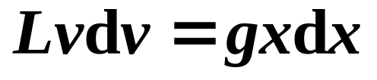
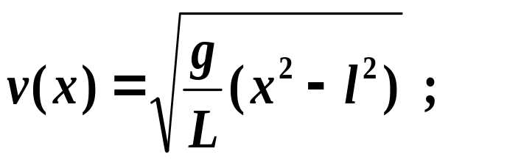
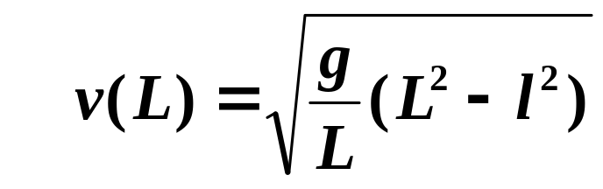
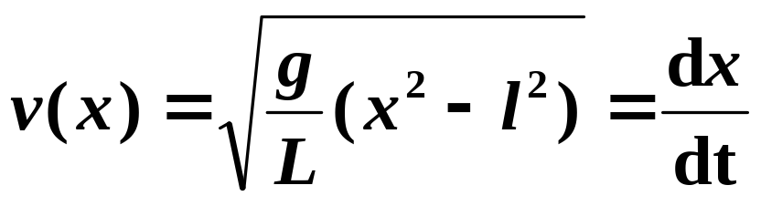
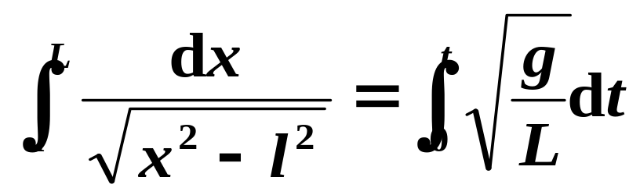
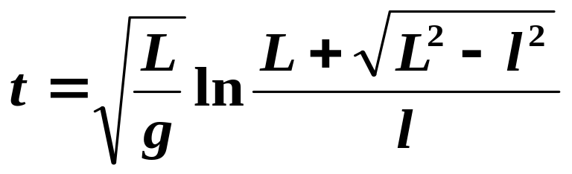
(variable);
(b)
so
Notes:
a=dv/dt=dx/dt*dv/dx

Slide 22
The problems of chapter4:
41, 56
The problems of chapter 5:
33, 55, 56, 57, 59, 63

